Slide 1
Tidy Data

Slide 2
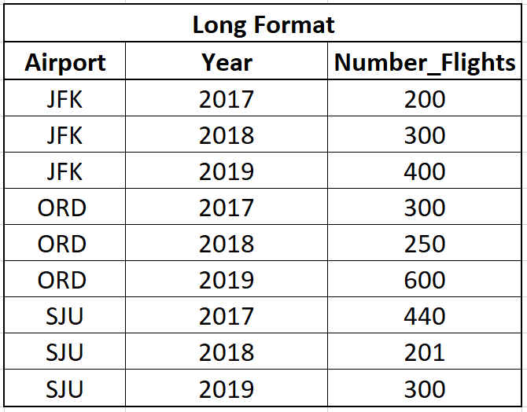
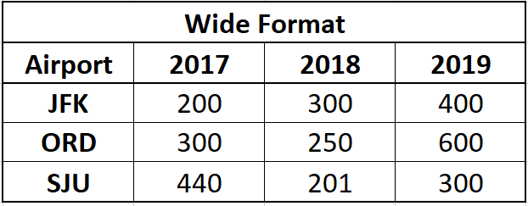

Slide 3
pivot_longer() Function
Command Illustration
new_dataframe <- wide_dataframe %>%
pivot_longer(cols = -column_name, names_to = "name_column1", values_to = "name_column2")

Slide 5
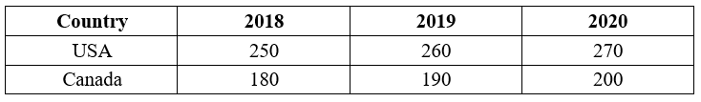
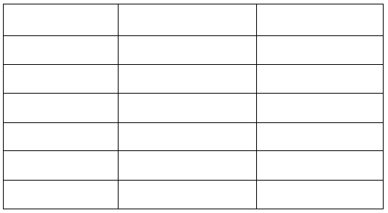
Example 1: Use pivot_longer to reshape the following wide data
First write out what the output should look like and then write the code that should make that happen.

Slide 6
Code:

Slide 7
pivot_wider() Function
Command Illustration
new_dataframe <- long_dataframe %>%
pivot_wider(names_from = column_name1, values_from = column_name2)

Slide 9
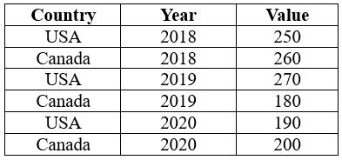
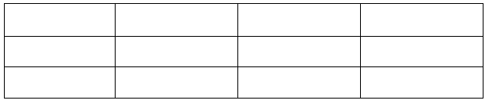
Example 2: Use pivot_wider to reshape the data
First write out what the output should look like and then write the code that should make that happen.

Slide 10
Code:

